Slide 1
CSE 4128 Lab 1
Topic: Convolution
Conduct By-
Dr. Sk. Md. Masudul Ahsan
Professor
Dept. of CSE
Dipannita Biswas
Lecturer
Dept. of CSE

Slide 2
Installation
Download Anaconda installer.
Installation link: https://docs.anaconda.com/anaconda/install/
OpenCV installation on Anaconda prompt:
pip install opencv-python pip install opencv-contrib-python
For updating pip: python -m pip install --upgrade pip

Slide 3
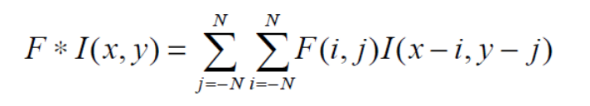
Convolution
The convolution operation applied on Image I using a kernel F is given by

Slide 4
Kernel
So satisfy this equation, the kernel is first flipped by an angle of 180 degrees and is then applied to the image.
1 | 2 | 3
4 | 5 | 6
7 | 8 | 9
9 | 8 | 7
6 | 5 | 4
3 | 2 | 1

Slide 5
1 | 1 | 0 | 1 | 0
0 | 0 | 1 | 0 | 0
0 | 1 | 0 | 0 | 1
1 | 0 | 1 | 0 | 1
0 | 1 | 1 | 1 | 0
1 | 0 | 1
0 | 1 | 0
1 | 0 | 1
F
I(X,Y)

Slide 6
1X1 | 1X0 | 0X0 | 1 | 0
0X0 | 0X1 | 1X0 | 0 | 0
0X1 | 1X0 | 0X1 | 0 | 1
1 | 0 | 1 | 0 | 1
0 | 1 | 1 | 1 | 0
1 | 0 | 1
0 | 1 | 0
1 | 0 | 1
1
F
I(X,Y)

Slide 7
1 | 1 | 0 | 1 | 0
0 | 0 | 1 | 0 | 0
0 | 1 | 0 | 0 | 1
1 | 0 | 1 | 0 | 1
0 | 1 | 1 | 1 | 0
1 | 0 | 1
0 | 1 | 0
1 | 0 | 1
1 | 4
F
I(X,Y)

Slide 8
1 | 1 | 0 | 1 | 0
0 | 0 | 1 | 0 | 0
0 | 1 | 0 | 0 | 1
1 | 0 | 1 | 0 | 1
0 | 1 | 1 | 1 | 0
1 | 0 | 1
0 | 1 | 0
1 | 0 | 1
1 | 4 | 1
F
I(X,Y)

Slide 9
1 | 1 | 0 | 1 | 0
0 | 0 | 1 | 0 | 0
0 | 1 | 0 | 0 | 1
1 | 0 | 1 | 0 | 1
0 | 1 | 1 | 1 | 0
1 | 0 | 1
0 | 1 | 0
1 | 0 | 1
1 | 4 | 1
4
F
I(X,Y)

Slide 10
1 | 1 | 0 | 1 | 0
0 | 0 | 1 | 0 | 0
0 | 1 | 0 | 0 | 1
1 | 0 | 1 | 0 | 1
0 | 1 | 1 | 1 | 0
1 | 0 | 1
0 | 1 | 0
1 | 0 | 1
1 | 4 | 1
4 | 0
F
I(X,Y)

Slide 11
1 | 1 | 0 | 1 | 0
0 | 0 | 1 | 0 | 0
0 | 1 | 0 | 0 | 1
1 | 0 | 1 | 0 | 1
0 | 1 | 1 | 1 | 0
1 | 0 | 1
0 | 1 | 0
1 | 0 | 1
1 | 4 | 1
4 | 0 | 3
F
I(X,Y)

Slide 12
1 | 1 | 0 | 1 | 0
0 | 0 | 1 | 0 | 0
0 | 1 | 0 | 0 | 1
1 | 0 | 1 | 0 | 1
0 | 1 | 1 | 1 | 0
1 | 0 | 1
0 | 1 | 0
1 | 0 | 1
1 | 4 | 1
4 | 0 | 3
1
F
I(X,Y)

Slide 13
1 | 1 | 0 | 1 | 0
0 | 0 | 1 | 0 | 0
0 | 1 | 0 | 0 | 1
1 | 0 | 1 | 0 | 1
0 | 1 | 1 | 1 | 0
1 | 0 | 1
0 | 1 | 0
1 | 0 | 1
1 | 4 | 1
4 | 0 | 3
1 | 4
F
I(X,Y)

Slide 14
1 | 1 | 0 | 1 | 0
0 | 0 | 1 | 0 | 0
0 | 1 | 0 | 0 | 1
1 | 0 | 1 | 0 | 1
0 | 1 | 1 | 1 | 0
1 | 0 | 1
0 | 1 | 0
1 | 0 | 1
1 | 4 | 1
4 | 0 | 3
1 | 4 | 2
F
I(X,Y)

Slide 15
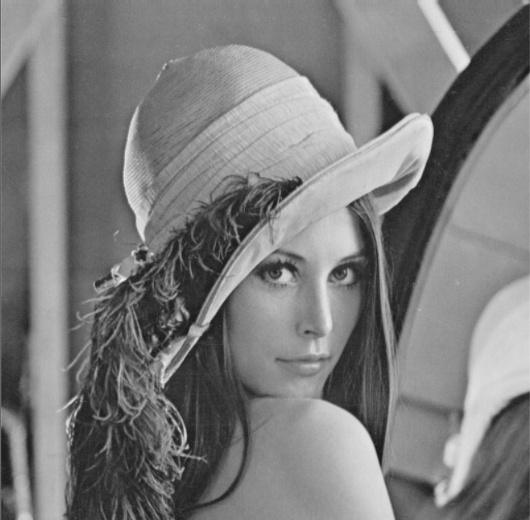

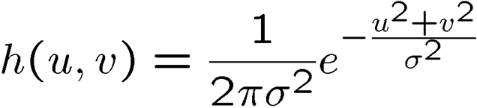


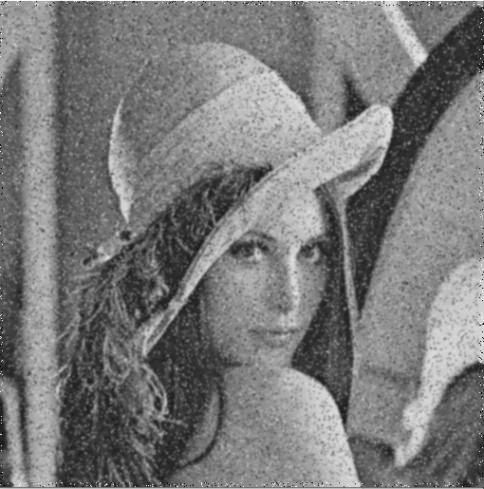
Gaussian Kernel
1 | 2 | 1
2 | 4 | 2
1 | 2 | 1

Slide 16
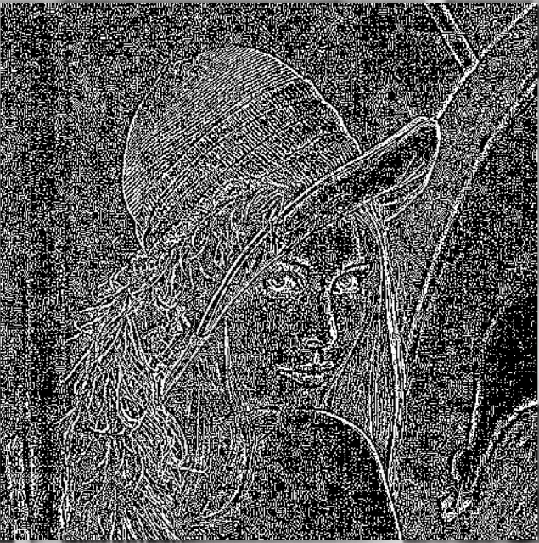
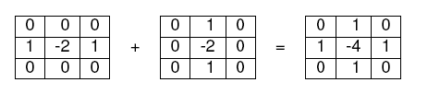

Laplacian Kernel
$$g(x,y)=\begin{matrix} \\ f(x,y)+∇^{2}f(x,y)\end{matrix}$$

Slide 17
Sobel Kernel
-1
-2
-1
-1
0
1
0
0
0
-2
0
2
1
2
1
-1
0
1

Slide 18
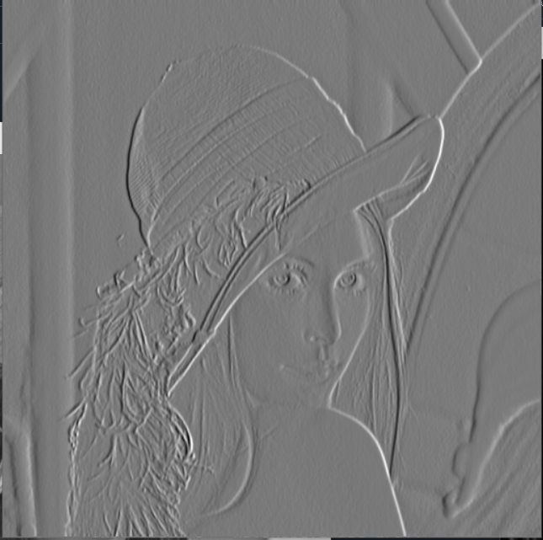
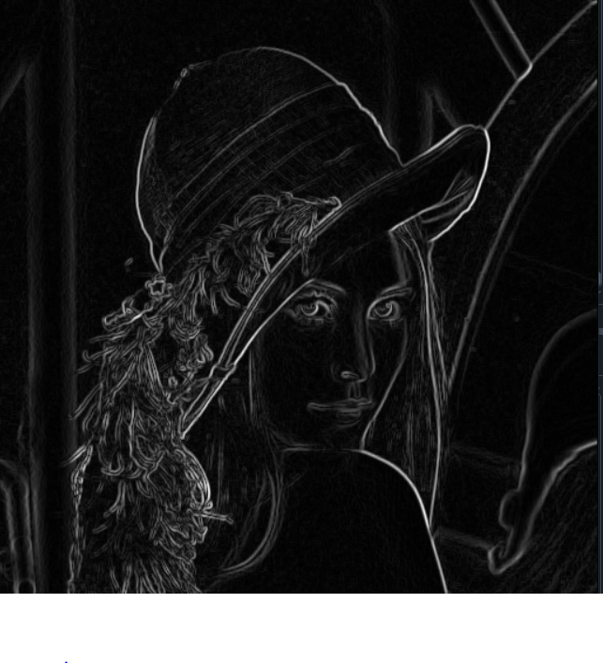
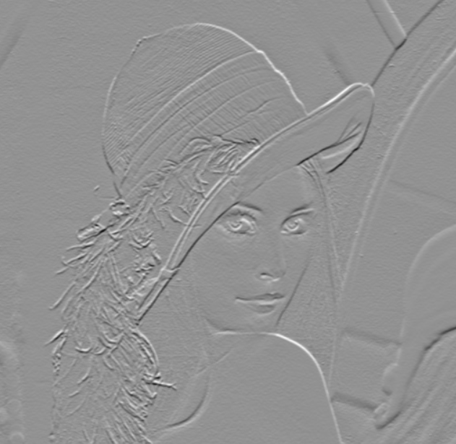
Gradient Magnitude

Slide 19
Homework
Point-processing:
Gamma
Inverse-log
Contrast stretching
Filtering
Mean
Median
Gaussian

